Slide 1
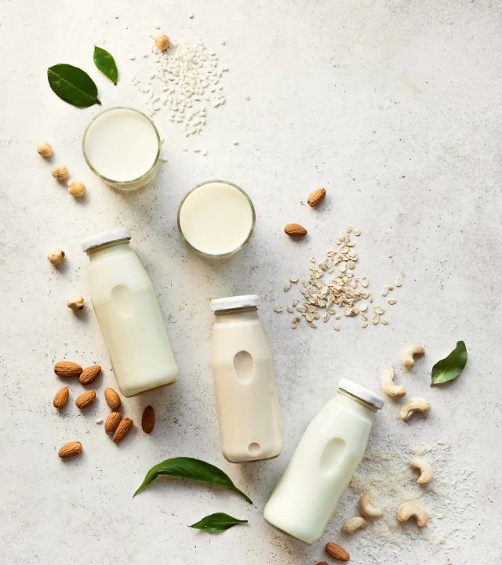


Alpro Sustainability Claims
SKIM Proposal
Prepared for Alyssa Martin and team
June 2023 | F9097
For this proposal, the conditions apply that are defined in the Master Service Agreement between DANTRADE B.V. and SKIM group B.V.

Slide 2

Nice to be working together again!
Thank you for giving us the opportunity to share our view on how to further drive the growth of Alpro by getting the consumers’ perspective on sustainability claims.

Slide 3



Proposal Summary
What you want to achieve
How we’re going to help
Why we’re excited to help
The business objective is to create and validate sustainability claims that are consumer friendly (easy to understand) and legally approved.
While these are being considered, it is also important to make sure that the claims fit the brand and are unique compared to competitors.
We are proposing a two-step approach:
The first step is a claims creation workshop in which we will spend 4-5 hours formulating and narrowing down potential claims to be used in future packaging.
We will use the claims created and test which ones perform the best using our Unspoken methodology.
We value the collaborative spirit of Danone and are excited to pair our analytical rigor with your market and category experience.
Besides rigor, our hands-on consultative approach allows for effective translation of results into strategy & actions, and we are looking forward to being part of your growth story.
Deliverables | Markets | Sample
Workshop Full Report deck (Online) Debrief session | UK Germany Italy Sweden | QualBites, n=500 in Germany n = 500 per market Users and Non-Rejectors of Alpro (Drinks and Yoghurts)

Slide 4


What we can do for you
1 | The opportunity
2 | Considerations 3 | Our approach in detail 4 | Timeline and investment

Slide 5

The opportunity

Slide 6
Objectives
Business Background
Alpro has found a challenge with claims under the topic of sustainability. As a whole, the topic is gaining awareness from the consumer perspective. Consumers want to make more conscious choices (part of which can be the choice for plant based rather than traditional dairy), and Alpro wants to highlight its sustainability efforts to consumers.
Immerse into a sustainability mindset and ensure all parties involved are aligned on the sustainability practices of the brand.
Understand and create different claims/narratives around sustainability to fit the Alpro brand and their products. These claims can help Alpro differentiate versus its competitors.
Across countries, language differences and legal regulations should be considered.
Get consumer feedback to the claims to understand which perform best and why? Are there messages that even show a bridge between sustainability and taste or sustainability and health in consumer minds?

Slide 7
SKIM will provide answers to the following research objectives
Business Opportunity
There is a need to identify what claims, related to sustainability, consumers find most relevant and convincing in order to buy Alpro products.
Through this research, Alpro can gain insights based on SKIM knowledge around the topic, as well as collecting new insights specific to the brand, to see how they can improve their links to sustainability.
The goal is to identify consumer friendly claim that highlights Alpro’s sustainability efforts and benefits.
What (sustainability) claims are the most attractive to consumers?
Why do these claims perform better/worse?
How do these claims perform on KPIs?
Which claims ladder up to health and/or taste benefits?
How do health/taste related claims perform versus those that only cue sustainability?
Which claims generate the highest purchase intent?

Slide 8

Considerations

Slide 9
Factors shaping our recommended approach
Claims Generation Workshop |  | The base of the claims generation workshop is recommended to stay in line with Danone’s Claims Lab. However, given the specific nature of sustainability claims, it will be good to make some adjustments. Setting the scene: it is important for all participants to understand the role of a sustainability claim – it will not replace the main messaging for the brand. Getting familiar with sustainability messaging: which claim inspiration is already out there that shows a consumer centric way of sustainability messaging? Assessing what is possible from the start: for this workshop we understand the benefit of having someone who represents the legal department in the room. There is no point in spending a lot of time on claims that are not legally acceptable. In general, for the Claims Lab it will be important to get a good variety of participants. If the different markets are present, it might be good to facilitate time outside of the workshop for them to catch-up. This will allow for more focus during the workshop.
Claim Comparability |  | When testing the claims against each other, we must make sure that the claims being tested are all related to sustainability, and that in order to get accurate results, we cannot test sustainability claims against first priority claims such as taste, or health. It will be interesting to explore which sustainability messaging is also able to cue taste and /or health benefits
What is allowed and what do consumers want to hear? |  | Finding a balance between claims that are allowed (e.g., legally) and that are consumer centric will be difficult. During the workshop SKIM will provide the team with education on the golden rules for claim creation. As mentioned above, there should also be someone who is a gatekeeper on what is legally allowed.
The Use of Eco labels |  | Generally, recognised eco-labels allow brands to show their sustainability efforts. Considering that Danone has eco-labels that can be used, we can test which ones perform better than others. To do this, we recommend testing them using two separate Unspoken tasks due to the fact that in a trade-off, consumers tend to favour eco-labels over claims. If Danone would like to explore the best combination of claims and eco-labels shown together, a different set-up for phase two is required. Hence that would be something to further discuss.
Country Nuances |  | Naturally, countries could have different priorities, or regulations, leading to a different set of claims to be tested. In order to allow for both comparability and flexibility, our recommendation is to have 75% of the same claims across markets and the remaining claims can be more tailored to account for these local nuances.

Slide 10



SKIM Claim Creation Guidelines
Consumers
When deciding what brand to choose, people often form a mental image of the product experience and emotional state they desire
PSYCHOLOGICAL DISTANCE is a concept in human psychology that describes how concrete an object or event feels. Strong claims drive short-term consumer behavior by lowering the distance between what a brand promises and a consumer desires – SO HOW CAN WE REDUCE IT?
1. Be specific - Being specific in describing what benefits are being offered helps create a vivid picture of the brand promise in the consumer’s mind. This decreases psychological distance and creates a concrete mental representation about the product and its benefits.
2. Use simple language - Avoid jargon and complex or ambiguous language to ensure consumers understand what is being said. Without comprehension, there is no meaning and without meaning the probability to successfully project a tangible brand promise is limited.
3. Be positive - A consumer’s desired product experience and end state is always positive, so using a positive tone of voice is key. A negative tonality could create a distortion between the positive image people have in mind and the promise projected by the brand.
4. Cue senses - Use words that encourage mental imagery by triggering memories, emotions and reactions linked to sensorial cues stored in memory. Examples are words like ‘taste’, ‘touch’, ‘enjoy’ or direct references like ‘creamy’, ‘silky’ or ‘melts in your mouth’.
Brands
To trigger consumers to choose your brand over competition, it should project a promise through its words that matches the mental image consumers have in mind
Match Connect Trigger Action
Reducing psychological distance helps close the gap between what the brand offers (projected product experience) and what the consumer wants (desired product experience).
WHAT ELSE TO KEEP IN MIND?
5. Be respectful – Avoid being condescending, presumptuous or offending. It is not unusual to unintentionally make judgmental assumptions about consumers in claims, so be careful not to.
6. Put the key benefit first - You only have a split second to capture a consumer’s attention, so it is critical to open your message with what matters to them most.
Strong claims contribute to lowering the distance and creating a meaningful connection between brand and consumer that triggers the consumer to choose your brand over competition

Slide 11


5 principles to consider for sustainability messages in particular
Don’t try to replace primary benefits
Including sustainability drives uniqueness
#
State 100% whenever possible
Focus on the positive and be clear & simple
Show tangible impact that is relevant

Slide 12
Consumers relate sustainability most closely to health and price. But it can also ladder up further to quality and taste
Sustainable products use fewer chemicals, pesticides, and preservatives
Higher-quality raw materials, locally sourced (France), and processing means a higher-quality product
Health
Price
Taste
SUSTAINABILITY/
ECO-FRIENDLINESS
Quality
Less processing means fresher and better ingredients
More mindful production, resources and employment, less shortcuts may make sustainable products cost more
Source: SKIM study

Slide 13

Our approach in detail

Slide 14

At SKIM, we take a consultative approach with our clients
Understanding Your Needs Our starting point will be consultation and collaboration with the Alpro team. This collaboration starts with a kick-off session and then flows through everything we do, from stakeholder alignment to a final presentation. | Upfront Alignment Kicking off the project between SKIM and Alpro research teams ensures that we have everything we need to tailor this research to your needs. | Collating Inputs Creating and gathering the inputs (i.e., the claims to be used) for the study will be a collaborative process. Together, we will collate the final inputs from the workshop and integrate them into the consumer study.

Slide 15



For this business question, we propose an extended two-step approach:
Phase 1a: QualBites
Phase 2: Consumer feedback
A Qual-inspired methodology at quantitative pace and scale. This pre-phase will help us explore consumers’ understanding of the link between sustainability and taste/health. This can serve as inspiration for the claims ideation in the workshop.
Inputs from Phase 1 will be evaluated in order to shed light on the most relevant and impactful claims for consumers.
Here, we can understand:
Which claims are most motivating to buy Alpro
Why certain claims are more/less motivating
How the claims perform on specific KPIs (e.g,. purchase intent, relevance, uniqueness, brand fit)
Which claims ladder up to cue health / taste benefits
What is the impact of cueing health / taste benefits
Phase 1b: Workshop
Have a workshop with key stakeholders and other expert views that work on creating claims together.
Participants will immerse themselves in the topic of sustainability claims, and ideate and refine claims. The output of the workshop is a list of claims that can go to a copywriter (and legal if needed) for a final refinement.

Slide 16

Phase 1: Optional Qual Bites

Slide 17

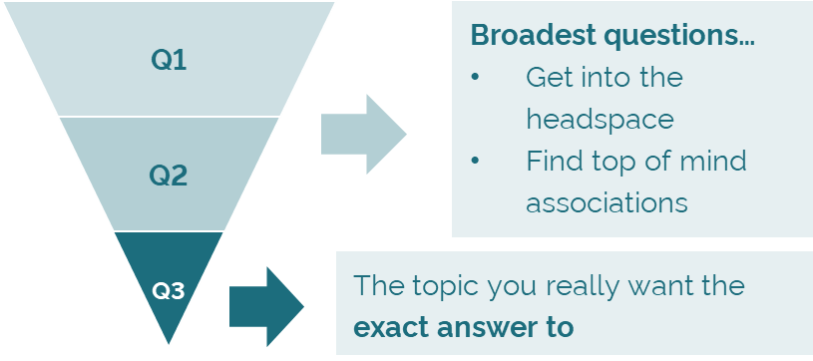
An open-ended question survey, containing maximum 3 questions.
(plus, a short screener if needed)
Qual-inspired methodology, at quantitative pace and scale
What
More illuminating open ends versus regular surveys
A way to scratch the surface more into the ‘why​’
A way to get more consumer language around a topic area​
Can send out to a larger sample ​
Short & engaging, easy to understand ​
Written using qualitative / projective questioning techniques ​
Sent to a quant panel
Respondents are asked to write/tell a story, respond to a situation or explain associations
Who
How
Only 3 questions are asked, using the Funnel Approach

Slide 18

Qual Bite thought starters
Starting with qual bites will help us understand what language consumers use to talk about sustainability and which words they use to make the association to health.
Learnings from this phase can allow us to aid the process in the Claims Lab when trying to ideate sustainability claims that ladder up to health benefits.
Q1
Q2
Q3
Meet Hellen. Hellen needs some help to understand what sustainability in food products means. Please describe what the first things are that come to mind for you in helping her understand this topic.
Which words would you use to help Hellen understand the benefit of sustainability on her (and her family’s) health?
Hellen read somewhere about regenerative agriculture. However, she is not entirely sure what the benefits of regenerative agriculture are. Tell us which benefits you think are important coming from regenerative agriculture? Can you also link this to health?
NOTE: These questions serve as an example and can/will be adjusted.

Slide 19
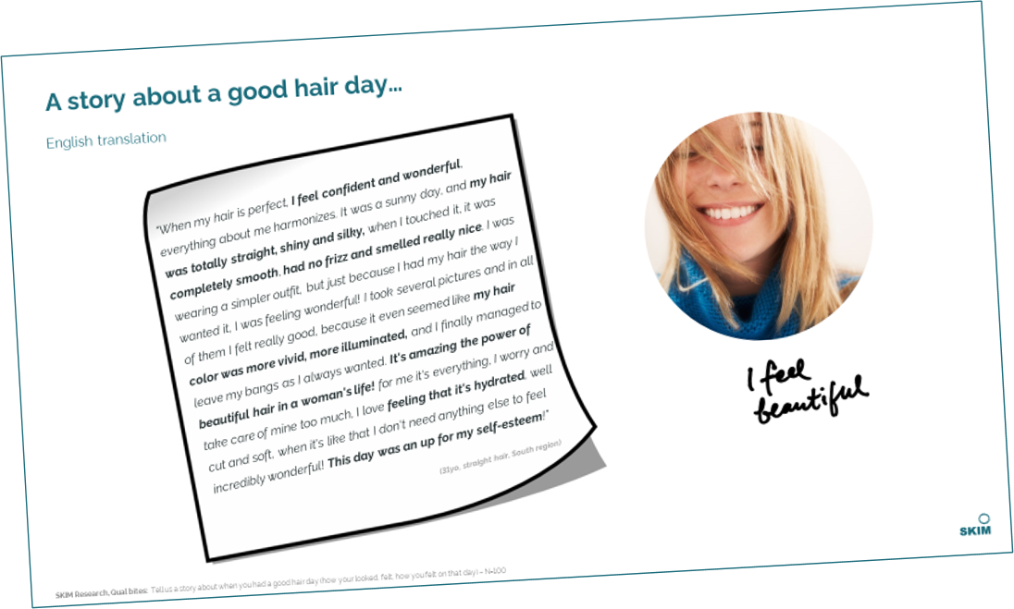


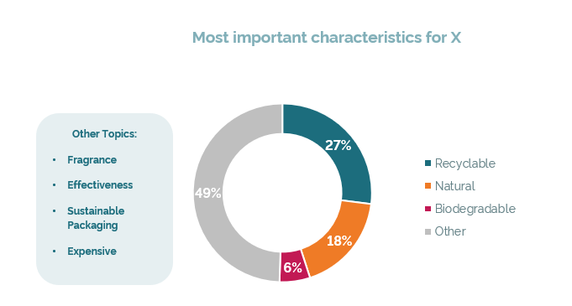
output examples
Consumer generated functional and emotional themes
Consumer stories that contextualise the themes
Cultural differences in reactions to a topic
Identify popular consumer language
In contrast with traditional survey open ends, the responses we receive from Qual Bites are more detailed.
Responses to projective story-based questions around brand personalities should yield rich insights.

Slide 20




We recommend (initially) focusing on one market for QualBites
Who we will speak to
Screening Criteria
Women, Men
Age > 18 yo
Responsible for HH shopping
Users and Non-rejecters of Alpro
DE
Fieldwork specifications
N=100
Assumed Incidence Rate > 20%
< 5 min length
Device agnostic survey

Slide 21
Phase 1: Claims Lab

Slide 22

CLAIMs LAB STEP BY STEP
Claim Generation Process
0
1
2
3
4
5
PRE-WORK
IMMERSE
IDEATE
SCREEN & REFINE
FINALIZE
BRING IT TO LIFE
STEPS
Review tips and best practices
Bring outside in
→ connect with “lead users”
Filter & prioritize
Reformulate at best
Come up with winning list of claims
Think touchpoint, illustration, preliminary demos…
OBJECTIVES
Align & prepare participants to the upcoming workshop
Step into the workshop with the right mindset & information's
Full brainstorm to ensure limitless creativity on selected exploration areas
Copywriting to power claim
Legal pre-check before moving to consumer test
CLAIM LAB duration (4-5 hours session including breaks)
Preparatory time
(2 weeks before the Claim Lab)
TIMINGS
30-45 min
60-90 min
60-90 min
45 min
2 weeks
Notes:
Pre work – quell matériel
- Target / persona / competite review / Experience Brief / digest superiority data
Immerse – quel matériel
Repartage des key insights / connect with the intention the brand
Print des key insights per “chapters” (superiority facts) / sensory profiles ?
> TASTE
> PERFORMANCE
> TRUSTFUL / QUALITY
> PROCESS
IDEATE
Mode 20’ blitzkrieg – World Café
Diverge
SCREEN
Converge
An agile way to connect / inspire / step back with a “Lead User” (athlete ? Infleuncer?)
Un hyper peak performer et un exercice enthousiast + Influenceur

Slide 23
CLAIMs LAB STEP BY STEP
Claim Generation Process
0
1
2
3
4
5
PRE-WORK
IMMERSE
IDEATE
SCREEN & REFINE
FINALIZE
BRING IT TO LIFE
STEPS
45-60 min
For the purpose of a sustainability focused claims lab, we recommend more time for the immersion.
This part of the workshop will be used to (1) educate participants (by both SKIM and Danone) on sustainability, and (2) get into the sustainability mindset by discussing these questions:
What are the consumer jobs in your category related to carbon & climate?
How can we make carbon and climate claims matter more to consumers (to influence purchase)?
What are some of the compelling (and terrible!) examples of carbon messaging you’ve seen?
Notes:
Pre work – quell matériel
- Target / persona / competite review / Experience Brief / digest superiority data
Immerse – quel matériel
Repartage des key insights / connect with the intention the brand
Print des key insights per “chapters” (superiority facts) / sensory profiles ?
> TASTE
> PERFORMANCE
> TRUSTFUL / QUALITY
> PROCESS
IDEATE
Mode 20’ blitzkrieg – World Café
Diverge
SCREEN
Converge
An agile way to connect / inspire / step back with a “Lead User” (athlete ? Infleuncer?)
Un hyper peak performer et un exercice enthousiast + Influenceur

Slide 24
Internal
External
WHO’s IN THE ROOM? Participants
Legend:
Mandatory participants
Optional participants
Set of Danone cross functional experts & bringing outside in
Participants for the whole workshop
Participants only for a part of the workshop
Marketing
S&I
Legal / Food law
Sustain-ability
H&S
UX
Sales
Consumer Service
R&I
Adv. Tech.
Prod dev
Expertise on the brand, ambition, positioning, inno/reno, communications
Expertise on previous consumer (claims) research, BHT, internal analysis, etc.
Expertise on legal limits on what can or cannot be claimed.
NB : Important to be in a “Yes but…” / “Yes and…” mindset. Never say “No”!
Expertise on Danone’s sustainability efforts
Expertise on sales of the brand, distribution, customer reactions, BTL activations, etc.
Expertise on consumer feedback about the brand and the products and consumer language
Expertise on user experience in terms of recipe and packaging
Expertise on recipe, ingredients, NPD, etc.
Facilitator
Com. Agency
Designer / sketcher
Lead user
Claims AI Tool
Copy writer
Strat planner or creative?
Bringing to life claim / narrative / demo / illustration
Ex: Influencer / expert / Consumer + / KOL / Heavy user
Additional voice in the room
Generate more claim ideas: uncover new ideas and new language/phraseology/claim refinement
Turns claim ideas into successful / powerful claims from a consumer point of view

Slide 25




SKIM’s role in the workshop
Moderator
Claims Expert
Outsider
Timekeeper
SKIM will moderate the whole workshop. This means that we will be facilitating and leading the steps and discussions. We ensure that everyone remains engaged, and the output is actionable.
We will bring our expertise on claims creation and testing. We will share our best practices and guide participants to ensure the golden rules are applied (refining phase).
Contrary to all the participants who work with these products every day, SKIM will be able to bring an external eye to act as a representative of the consumer.
Since everyone’s time is valuable, we will make sure to respect the planned time per phase to make the most out of the workshop

Slide 26

Input / output of the workshop
Objectives of the session/brand
Open mindset of the participants
(Optional) Brand/background information as pre-read (to be provided by Danone)
Input
Output
List of claims ready for copy writing and testing

Slide 27
Phase 2: Consumer Screening

Slide 28



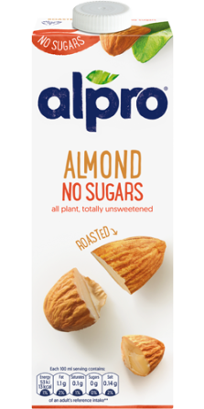
Do you find this message appealing?
Yes!
At the base of our intuitive approach is our Unspoken methodology
Try it for yourself: link to demo
This is a carbon neutral product
100% recyclable packaging
Interacts with stimuli in a natural way | Measures subconscious processes of the brain | Reduces response biases across global markets | Increases consumer engagement
Swiping, scrolling and tapping on our phones is the new normal. Unspoken replicates this natural behavior and ensures that we measure in the same way as people communicate with the world around them on a daily basis. | Traditional methods tend to focus on rational processes. By using an intuitive interface, Unspoken finds a better balance between rational and emotional (system 1) drivers. | The more rational a method the more prone it is to response biases. Asian and Latin countries can be especially sensitive to this. Unspoken has been proven to reduce response bias and reveal more true preferences. Read more here | The age of instant gratification has reduced attention spans significantly. Unspoken has been shown to generate much higher engagement than traditional surveys and delivers better data quality as a result.

Slide 29





The research design consists of 6 modules, including
There will be max. 20 claims in the study
First, respondents go through a screener to assess if they are the right audience for this study. This screener can also include certain current usage questions (e.g. by ingredient type) if specific splits of the sample are needed.
Swiping
Module
Trade-off
Module
Purchase Intent
KPI rating
Deep Dive
Health / taste perception
1
2
3
4
5
6
Swiping exercise to measure absolute appeal (metric TBD) of each claim through a binary swipe exercise
Trade-off exercise to determine relative motivation to buy (metric TBD)
Consumers indicate how likely they are to purchase the Alpro brand in the future
Consumers will evaluate several claims on different KPIs
Understanding why consumers like / dislike some claims
Consumers will evaluate claims on their ability to cue health / taste

Slide 30
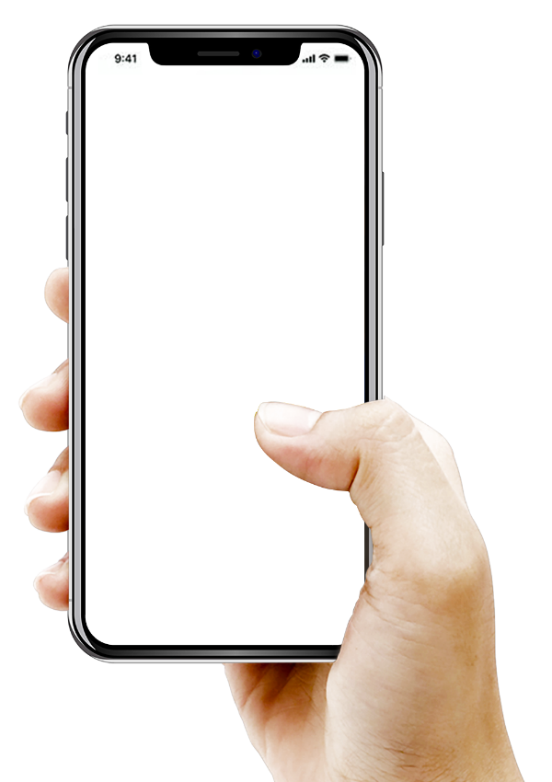
The swiping module
Methodology
1
The objective of the swiping module is to establish the absolute appeal (metric TBD) of all the claims.
Through several swiping exercises, consumers reveal which claims they prefer.
Unspoken can be tailored to the most relevant metric for Alpro e.g., Appeal, motivating to buy, superior, relevant, etc. Let’s discuss!
This approach is particularly good for measuring initial reactions – emotional, automatic, and associative – to stimuli. This module is aimed at determining the absolute appeal of each product.
Do you find this message appealing?
#1 high-protein drink
100% Plant- Based
No
YES

Slide 31
The trade-off module
Methodology
2
Once consumers have indicated their absolute appeal for the different claims, we will determine their relative motivation to buy (TBD) thanks to an intuitive tapping trade-off exercise.
In this module, consumers make trade-offs between competing options.
We will show 4 different claims at random and ask consumers to choose the option that would motivate them most to buy (TBD) Alpro products. There will be multiple screens.
We will then get a ranking of all the claims by motivation to buy (TBD).
Which message would motivate you most to purchase Alpro products?
100% recycled materials
100% plant based
#1 plant-based drink
Made from recyclable materials

Slide 32
Purchase Intent
Methodology
3
After the swiping and trade off modules, we will ask the purchase intent of the brand in the context of several claims.
How likely are you to purchase YoPRO products in the future if they say the following messages?
How likely are you to purchase Alpro products in the future if they say the following messages?
Zero plastic packaging
60%
Very unlikely
Very likely
Healthy high protein snack
Recyclable materials
40%
Very unlikely
Very likely

Slide 33
KPI rating
Methodology
4
To understand how claims are perceived, we will include some KPI assessments on the claims.
We can include up to 4 KPIs in this study.
To gain further understanding on consumers choices and ensure that the claims convey the desired effect, consumers will evaluate some claims on several KPIs (e.g., new and different, relevant, believable, superior).
Please rate this message on the following:
#1 high-protein drink
Less carbon emission
Is new and different
Is relevant
Is believable

Slide 34
Deep dive module – Qualitative Feedback
Methodology
5
At last, we will deep dive on the qualitative evaluation of the claims.
We will ask consumers what they liked or disliked about their most and least preferred claims from the trade off exercise, and why.
You found the following message more motivating than others. What do you like about this message and why?
#1 high-protein drink
Locally sourced ingredients

Slide 35
Health / Taste perception
Methodology
6
Finally, consumers will be asked to rate a random subset of claims on their ability to cue health / taste.
Even though this is asked in a stated way, we will use the results of this assessment to get to the derived importance of health / taste perception in the evaluation of the claims. (see next slides)
How important is it for you that a product gives you…
How likely are you to purchase YoPRO products in the future if they say the following messages?
How much do expect a product with this claim to give you health benefits?
#1 high-protein drink
Zero plastic packaging
Health benefits
60%
No
YES
Very unlikely
Very likely
Not at all
Very much
Healthy high protein snack
Recyclable materials
40%
Very unlikely
Very likely
Not at all
Very much

Slide 36
Understanding perceptions – both explicitly and implicitly
Stated Importance
Derived Importance
How is it calculated?
Using a swiping exercise, we ask consumers directly which perceptions resonate most when choosing a product.
What does it indicate?
It represents the stated importance given by consumers for each perception. It is an explicit measure of what is important.
It is vital to consider in parallel with derived importance because there is often a gap which exists between what consumers think resonates best versus what actually resonates. Consumers may not accurately (be able to) report the importance of certain perceptions in response to reading a claim.
How is it calculated?
In the Unspoken module, we measure and report consumer preference for each claim seen. In a separate and independent question, we ask them to rate each claim against a list of perceptions. We then infers which perceptions are most or least important, by claim, using statistical driver modelling.
What does it indicate?
It is an implicit measure of what is important. Perceptions that are systematically and strongly linked to preference outcomes are more ‘important’.
It is vital to consider in parallel with stated importance because perceptions that are consistently low scoring across all claims may appear ‘unimportant’. Strong explicit performance of these perceptions may indicate a gap between consumer expectations and how the claim is really performing.

Slide 37
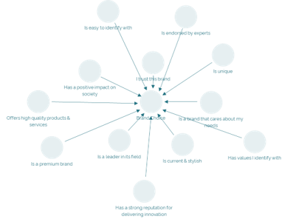
Shapley values regression
For each independent variable (perception) we measure the strength of the direct relationship between itself and the dependent (Unspoken preference) after stripping out its relationship between the other independent variables
Results – quantification of the most to least important perceptions for each claim
Notes:
for each independent variable, we derive a measure of the strength of the correlation between itself and the dependent after we have “stripped” out its correlations between the other independent variables.

Slide 38
Mapping perceptions into actionable quadrants
How to interpret the results
MUST HAVE PERCEPTIONS
Perceptions that are stated to be important, but do not have a correlation with a consumer’s claim preference. We need to at least meet expectations.
CLEAR BASIS OF CLAIM PREFERENCE
Perceptions that are both stated to be important and have a high correlation to a consumer’s claim preference. Strong areas for claim differentiation.
STATED Importance
LOW PRIORITY
Perceptions that are low stated importance and little correlation with a consumer’s claim preference.
LESS-CONSCIOUS BASIS OF CLAIM PREFERENCE
Perceptions that consumer's can not / do not identify at a stated level but do have a high correlation with a consumer’s claim preference. Strong potential for building claim differentiation.
DERIVED Importance

Slide 39
We cover 5 global markets
Who we will speak to
Screening Criteria
Women 50%, Men 50%
Age > 18 yo
Responsible for HH shopping
Users and Non-rejecters of Alpro
SE
UK
DE
Fieldwork specifications
N=500
Assumed Incidence Rate > 20%
< 15 min length
Device agnostic survey
FR
ES

Slide 40

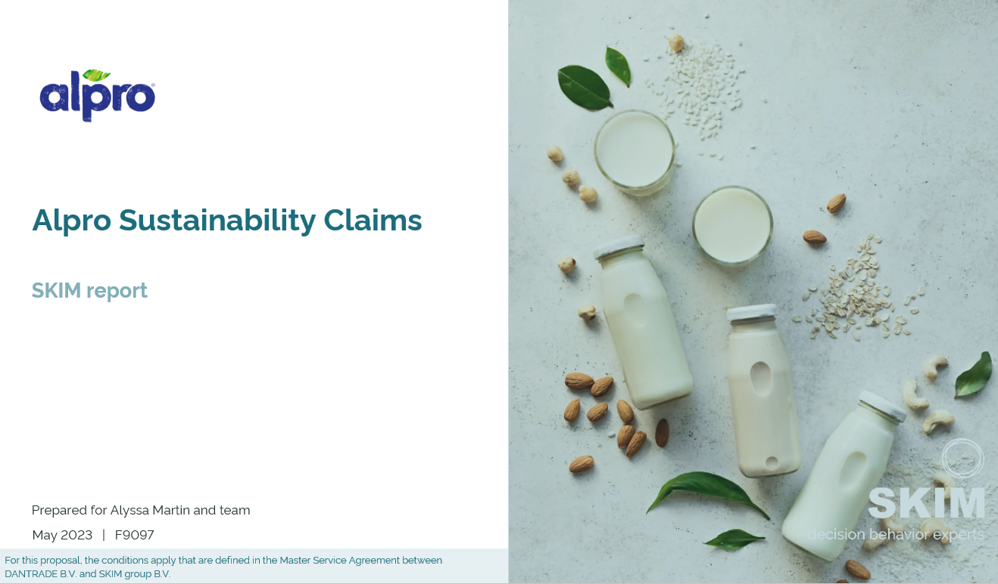
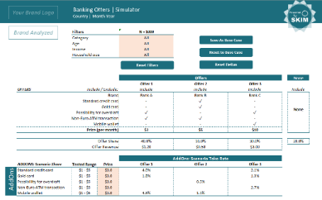
Deliverables & Insights
The key deliverables will be a consultative report with key findings, conclusions and recommendations the best performing sustainability claims of Alpro.
A consultative report
We will deliver a PPT report.
Debrief working session
A debrief of the final report and discussion on implications will be arranged between SKIM and Danone.

Slide 41



Key output: Impact Score
The impact score gives us an absolute score from 0-100 reflecting the strength of the stimuli
Do you find this message appealing?
Which message would motivate you most to purchase Alpro products?
Rank | Claim | Impact Score
1 | Claim 1
2 | Claim 2
3 | Claim 3
4 | Claim 4
5 | Claim 5
6 | Claim 6
7 | Claim 7
8 | Claim 8
100% recycled materials
100% plant based
100% Plant- Based
No
YES
#1 plant-based drink
Made from recyclable materials
Swiping What claims break through the clutter and attract people to the point of sale?
Trade off What claims convert shoppers into buyers at the moment of truth?
The Impact Score gives each stimuli a score between 0-100 reflecting the absolute performance of the stimuli, in terms of its ability to attract consumers to the shelf and convert them at point of sale.

Slide 42
Example Output: KPIs & Purchase Intent
This table shows data from the deep dive module, with the KPIs, as well as the Purchase Intent.
This scorecard shows how the claims score on the KPIs and PI.
Analysis will be done across all topics and within topic.
Based on the analysis of this and the previous slide we will be able to determine which are the recommended claims for the Alpro brand.
Scorecard
 | KPIs (T2B) |  |  | PI (T2B)
 | Unique | Relevant | Believable | Purchase Intent
Claim 21 | 78% | 74% | 76% | 83%
Claim 32 | 82% | 66% | 69% | 79%
Claim 4 | 67% | 81% | 70% | 82%
Claim 17 | 71% | 59% | 65% | 74%
Claim 28 | 88% | 77% | 79% | 69%

Slide 43
Example Output: Open ends – Why are the claims motivating to buy?
Claims about Alpro products
This shows a possible output for the qualitative part of the deep dive module.
With this, we can understand why some claims are liked or disliked.
Claims
Claim 18
Claim 36
Claim 6
Claim 15
Claim 27
LIKE, n=300
Important for my health | 55%
Healthy snack | 22%
DISLIKE, n=100
Too vague, doesn’t say what is inside | 28%
Sounds fake/hypocrite | 13%
It’s good for my health
It is a healthy snack after workouts
It doesn’t tell me why it’s healthy

Slide 44

Timeline and investment

Slide 45
Timeline for 5 countries
This timeline requires strong collaboration between Danone and SKIM
 | Week # | 0 |  |  |  |  |  | 1 | 2 | 3 | 4 | 5 | 6 | 7 | 8 | 9 | 10 | 11 | 12 | 13 | 14 | 15
 |  |  |  |  |  |  |  | Phase 1 |  |  | Phase 2 | Phase 2
Kick-off | Commissioning of project ^
 | Final inputs ready ^
Workshop | QualBites
 | Pre-work
 | Workshop Session
Research Design | Draft questionnaire
 | Danone feedback on questionnaire ^
 | Programming & testing ^
 | Translation of the questionnaire
Data Collection | Fieldwork
 | Data processing and analysis
Deliverables & insights | Topline report
 | Reporting
 | Country reports delivery & debriefs (on a rolling basis)
^ Key deadlines for Danone – if Danone does not meet the deadline, SKIM reserves the right to push the timeline forward accordingly Please note that SKIM will be closed during a holiday on the 29th of May.

Slide 46

Investment
Amounts are in EUR net cash, excluding GST/VAT and any other tax
 | Phase 1a QualBites | Phase 1b 4-5hrs Workshop | Phase 2 20 claims UK (First Market) | Phase 2 20 claims Germany | Phase 2 20 claims Italy | Phase 2 20 claims Sweden
SKIM fees | € 4,500 | € 7,000 | € 15,000 | € 11,500 | € 11,500 | € 11,500
Travel expenses |  | € 5,000 | - | - | - | -
Fieldwork & translations (n=500, IR=20%) | € 550 | - | € 2, 550 | € 2,700 | € 2,700 | € 3,700
Total investment | € 5,050 | € 12,000 | € 17,550 | € 14,200 | € 14,200 | € 15,200
PLEASE NOTE
Amounts specified are net cash (excluding GST/VAT, sales taxes, withholding taxes, and all other taxes)
If incidence rates fall out lower than the anticipated incidence rates of 20% SKIM may pass on any additional costs
60 days payment terms: 50% upon commissioning, 50% upon report delivery
For this proposal, the conditions apply that are defined in the Master Service Agreement between DANTRADE B.V. and SKIM group B.V.

Slide 47
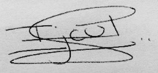
Terms of agreement
F9097 | 27th June 2023
Terms of payment: 50% upon contracting, 50% upon delivery of agreed services. Standard payment terms are 60 days after receipt of our invoice. Thereafter we will charge 1% interest costs per month. The amounts specified are net cash (excluding VAT, withholding tax, sales tax or any other applicable tax), without charges for the beneficiary. This proposal is valid for 2 months. ​
​Proposals offered and studies conducted by SKIM Analytical are bound by the terms of delivery as laid down by the Dutch ​“Marktonderzoek Associatie” (MOA).
Signatures for agreement
SKIM Iris van Loon | Danone Alyssa Martin
For this proposal, the conditions apply that are defined in the Master Service Agreement between DANTRADE B.V. and SKIM group B.V.
Deliverables | Markets | Sample
Workshop Full Report deck (Online) Debrief session | UK Germany Italy Sweden | QualBites, n=500 in Germany n = 500 per market Users and Non-Rejectors of Alpro (Drinks and Yoghurts)

Slide 48
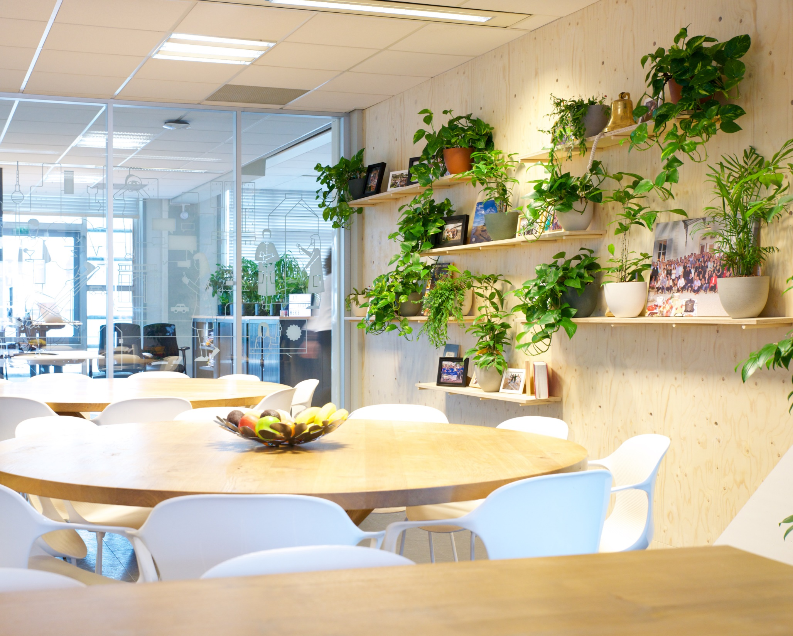






Thank you
Iris van Loon
Associate Director
i.vanloon@skimgroup.com
Elena le Gouic
Manager
e.legouic@skimgroup.com
Charlotte Newman
Analyst
c.newman@skimgroup.com
SKIMgroup.com

